Slide 1
Technical Support (420-1N6-AB) Binary Electronics & Logic Gates
Fall 2023

Slide 2
Boolean Logic & Logic Gates

Slide 3
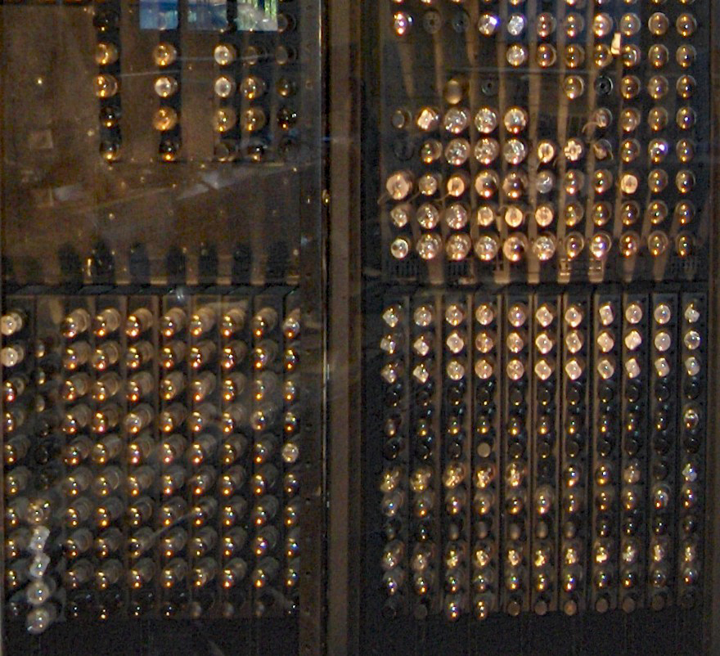
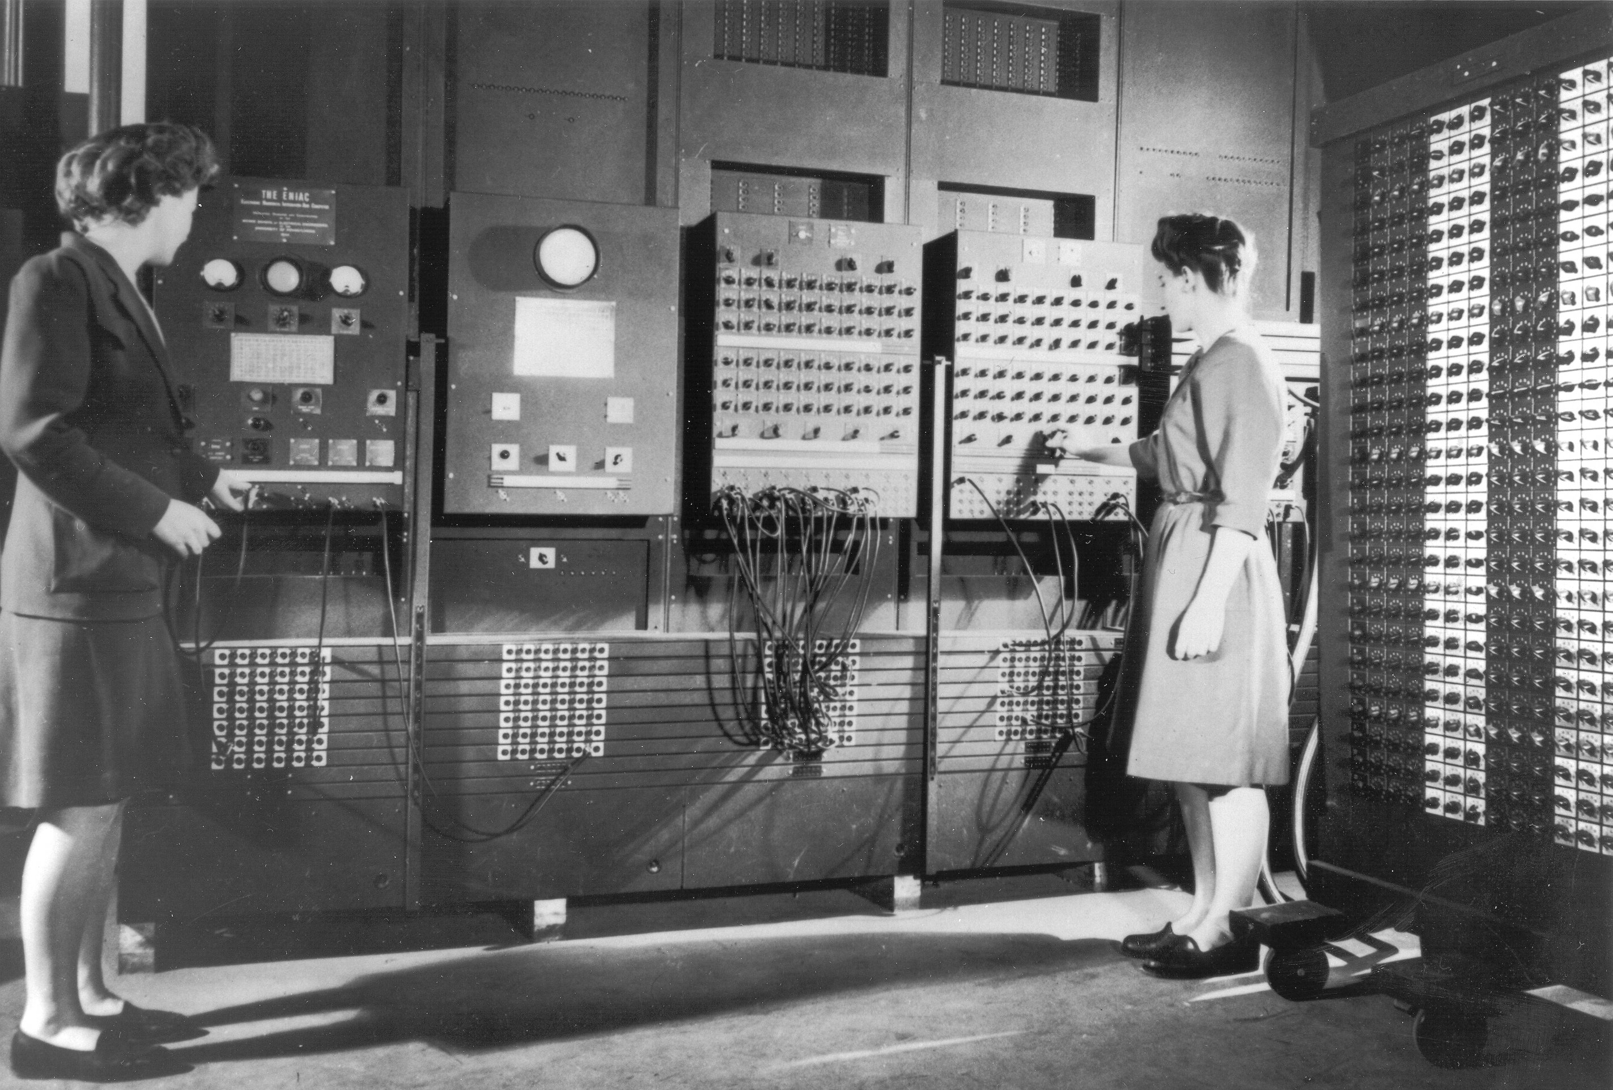
Fundamentals of logic circuit
1946 ENIAC Computer – First programmable electronic (stands for Electronic Numerical Integrator and Computer)
The first programmers Betty Jean Jennings and Fran Bilas at the School of Electrical Engineering. During the war, these women developed an expertise and became hard to replace by the returning soldiers.

Slide 4
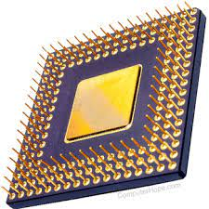
Logic in Electronics
Processors work by reacting to an input of 0s and 1s in specific ways and then returning an output based on the decision.
The decision itself happens in a circuit called a logic gate, each of which requires at least one transistor, with the inputs and outputs arranged differently by different operations.

Slide 5

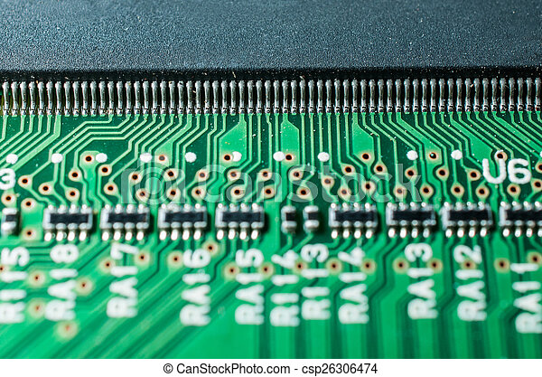

The advent of transistors
Invented in 1947, transistors revolutionized the computing world.
They came to replace the vacuum tubes that were used back then as signal regulator.
This is a 2nm IBM wafer containing hundreds if chips which allows 50 billion transistors onto a chip of a fingernail

Slide 6
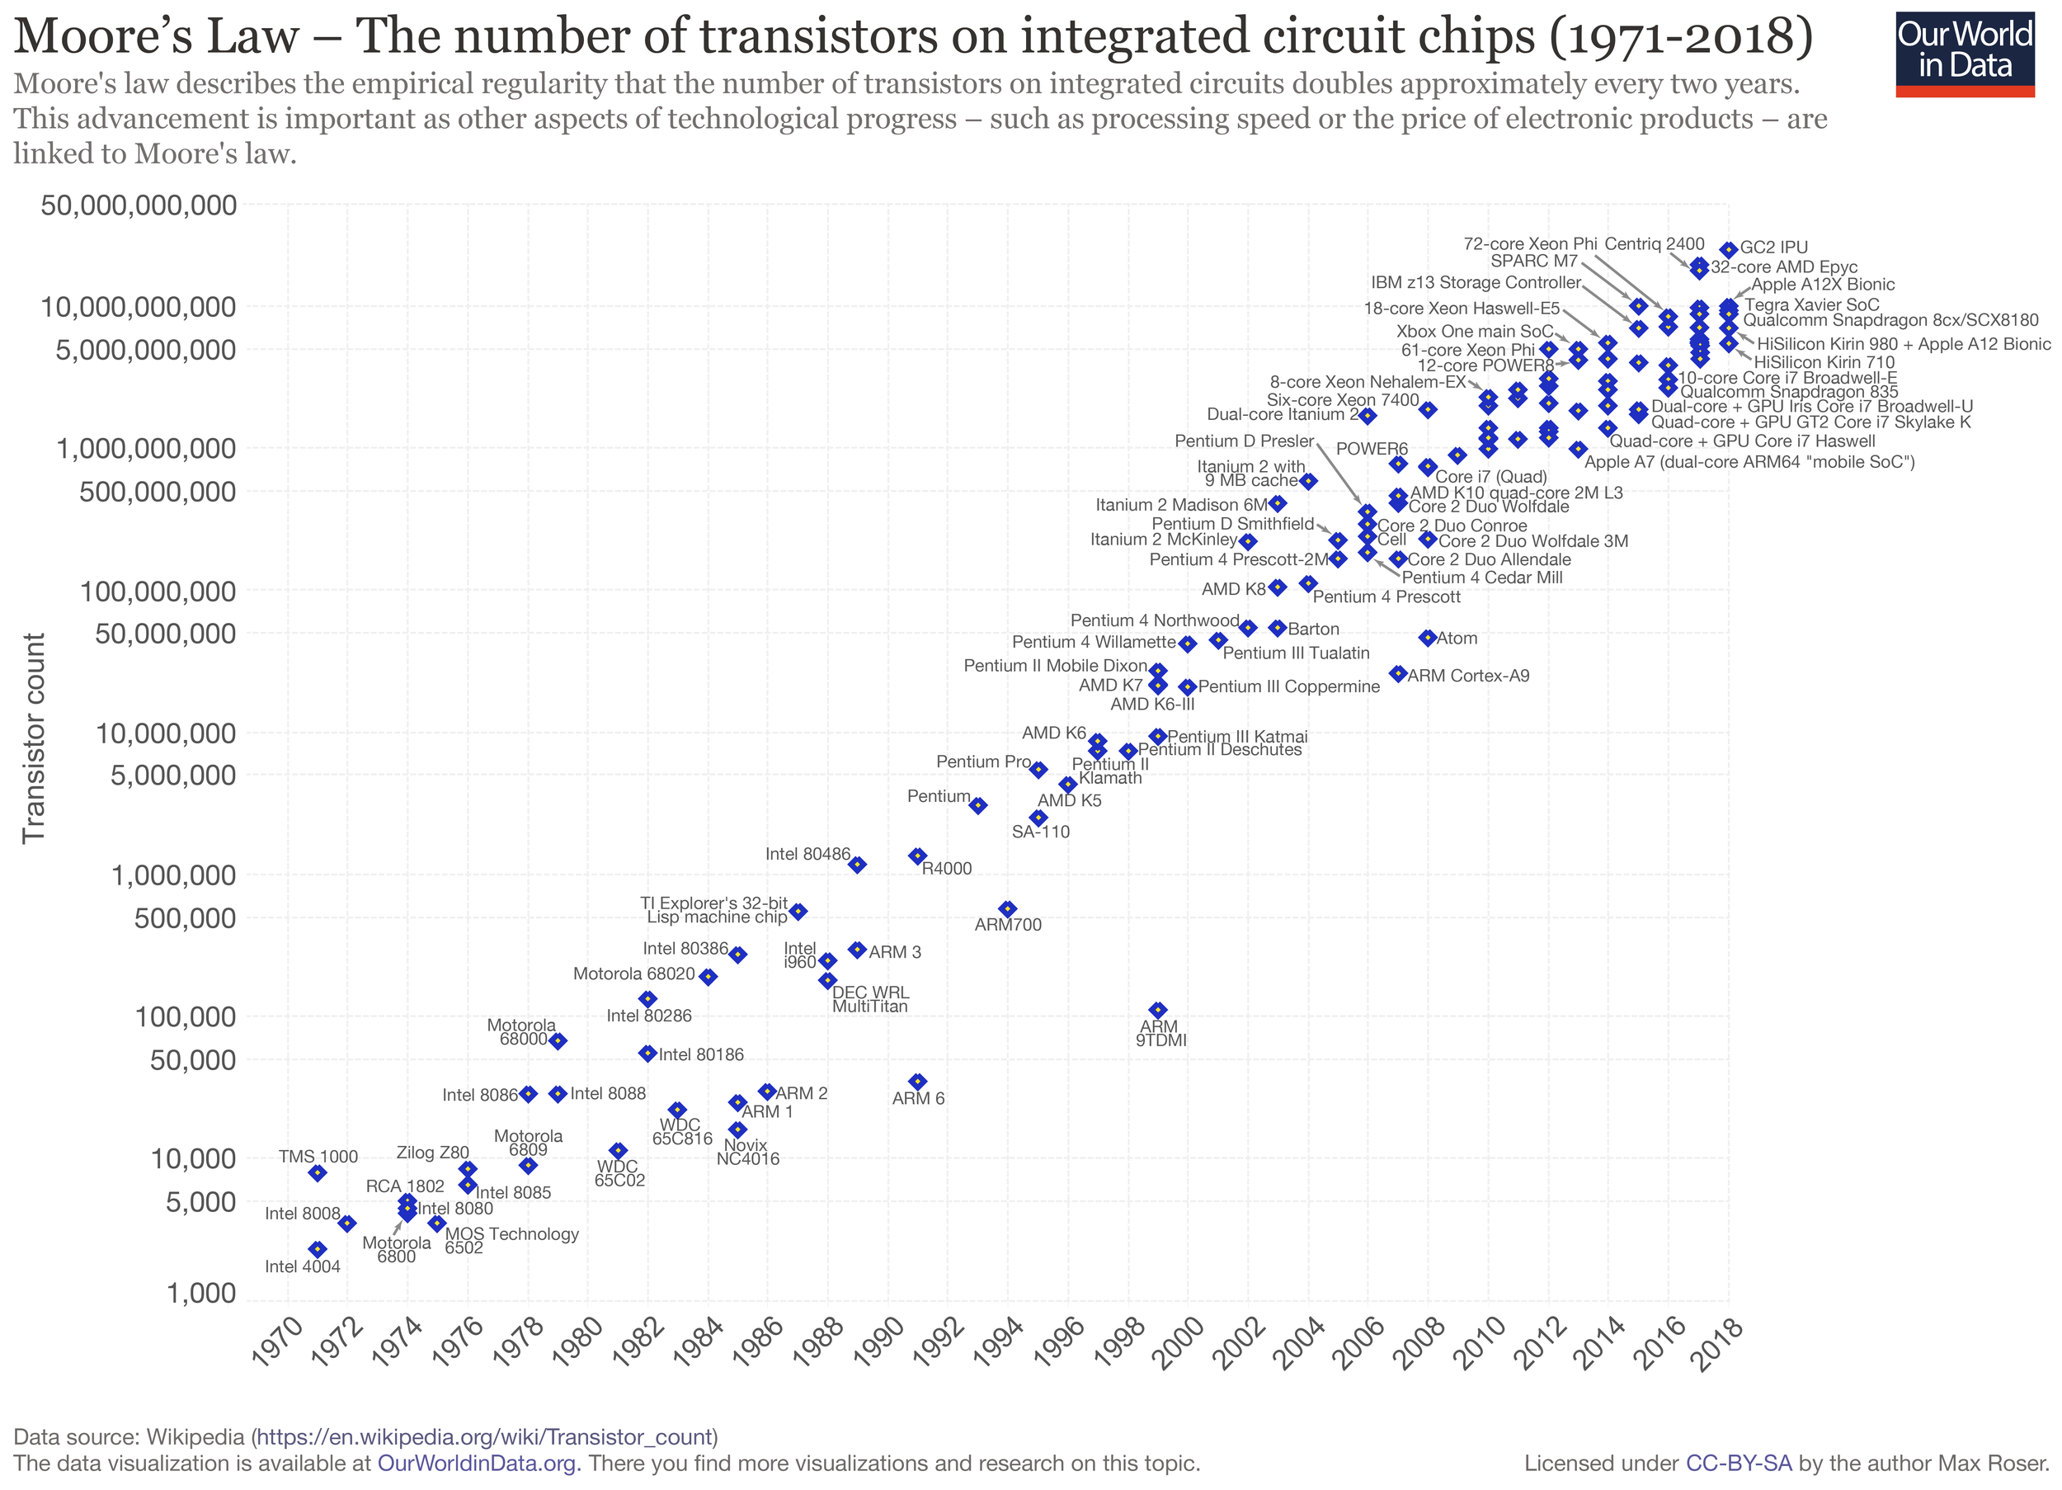
Transistors count in computers
Number of transistors in an integrate circuit (IC) doubles every two years.
BUT! Since 2010, semiconductor advancement has slowed industry-wide.
Physical limits of transistors

Slide 7
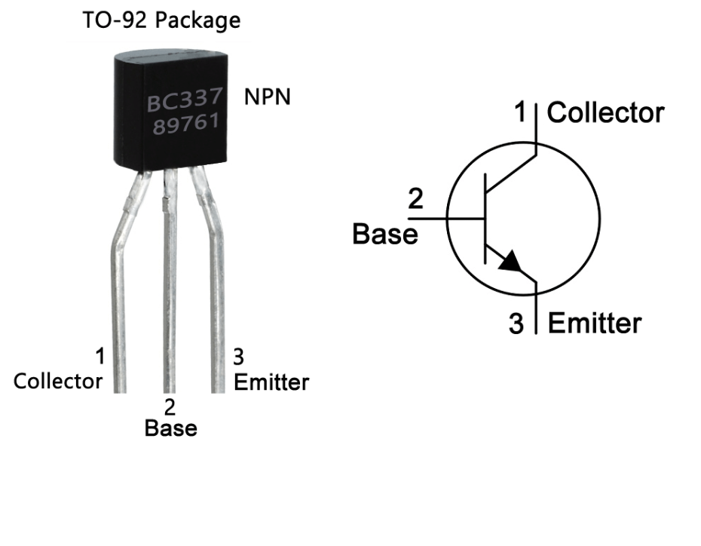
What is really a transistor
Miniature semiconductor element of a circuit that controls the voltage flow, amplifies it and can act as switch/gate.
Notes:
A transistor is a switch made up of three connectors called the Base, Emitter and Collector and finally a semi-conductor.
A base electrode you can control the semi-conductor (just like a light switch)
You can switch the current millions of times per second.
More transistors allows us to create the Boolean operations (And, OR, XOR, NOT)
The use those logic gates can be used to make math operation (adder, multiplexer)

Slide 8
Logic in Electronics
Electrical circuits are designed to represent logical expressions
Known as logic circuits.
Used to make important logical decisions in household appliances, computers, communication devices, traffic signals and microprocessors.
Four basic logic operations listed below:
OR operation
AND operation
NOT operation
XOR operation (eXclusive Or)

Slide 9
Boolean Operations
Integrated Circuits (microchips) are used to store and manipulate (process) bits.
Bits can be manipulated using Boolean Operations.
Boolean algebra: the mathematics of digital logic and Boolean operations.
Name Boolean for mathematician George Boole
Useful in dealing with binary systems where a variable can have a false of 0 or 1 (true or false).
Uses Boolean operations to manipulate one or more Boolean values.
Used in the analysis and synthesis of logical expressions.

Slide 10
Logic Gates
A logic gate is an electronic circuit/device which makes the logical decisions based on these operations.
Logic gates have:
One or more inputs
Only one output
Computes a Boolean operation.
The output is active only for certain input combinations.
Logic gates are the building blocks of any digital circuit.

Slide 11
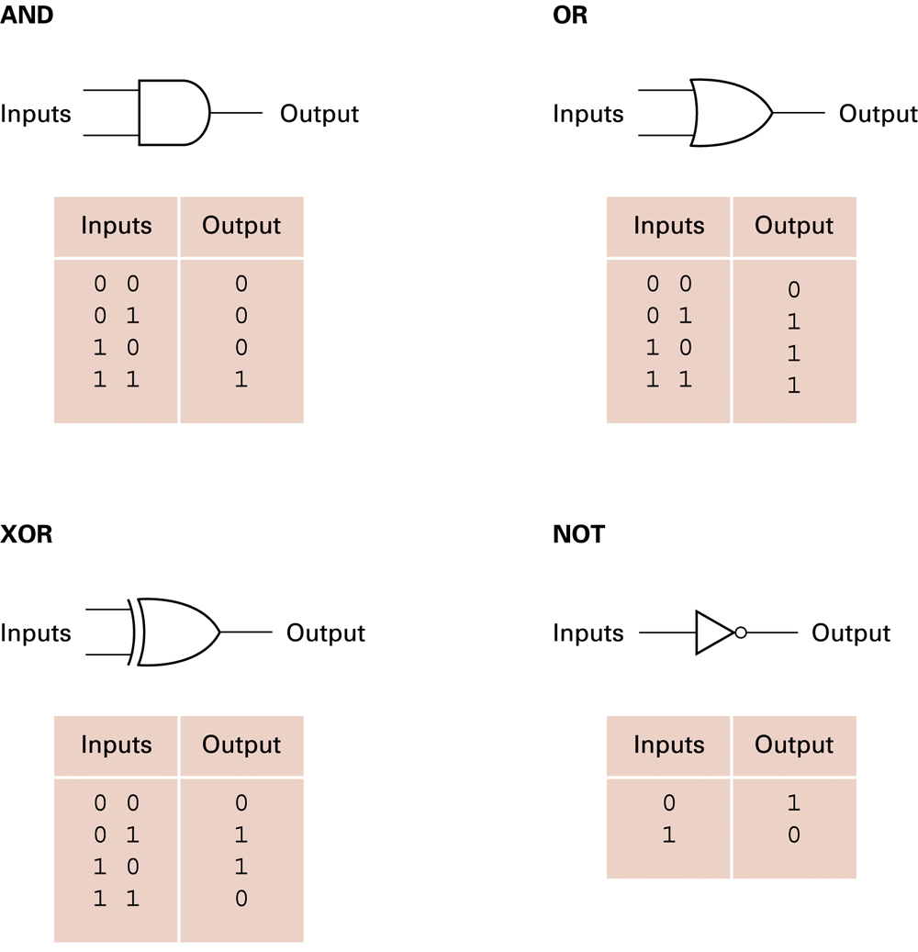
Logic Gate & Truth Tables
Using Truth Tables we can use different sets of logic operations to store, add, subtract, and perform more complicated operations with bits.

Slide 12


Boolean Operations: AND
TRUE
TRUE
AND
=TRUE
AND Operation
Both input values must be TRUE for output to be TRUE
Shrek is an ogre AND Fiona is a princess
Both inputs are TRUE, so the output is TRUE

Slide 13
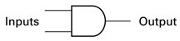
Boolean Operations: AND Gate
Truth Table
Inputs Outputs
0 0 0
0 1 0 0 = FALSE
1 0 0 1 = TRUE
1 1 1
AND Operation
Both input values must be TRUE for output to be TRUE
0
0
0
0
0
1
1
0
0
1
1
1

Slide 14
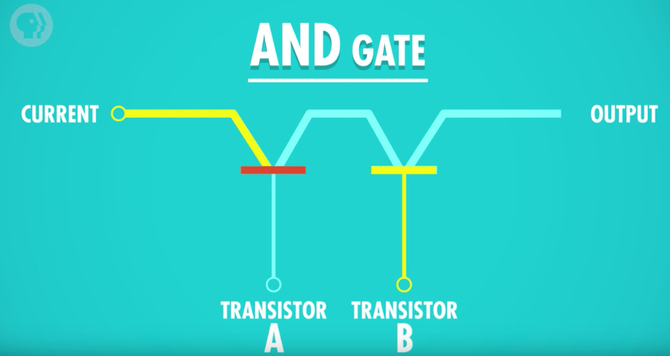
AND Gate
To build an AND gate: Two transistors connected together
Two inputs (transistors A and B) and one output
Transistor A: Off (False)
Transistor B: On (True)
Output: Off (False)
Off (False)
Off (False)
On (True)

Slide 15
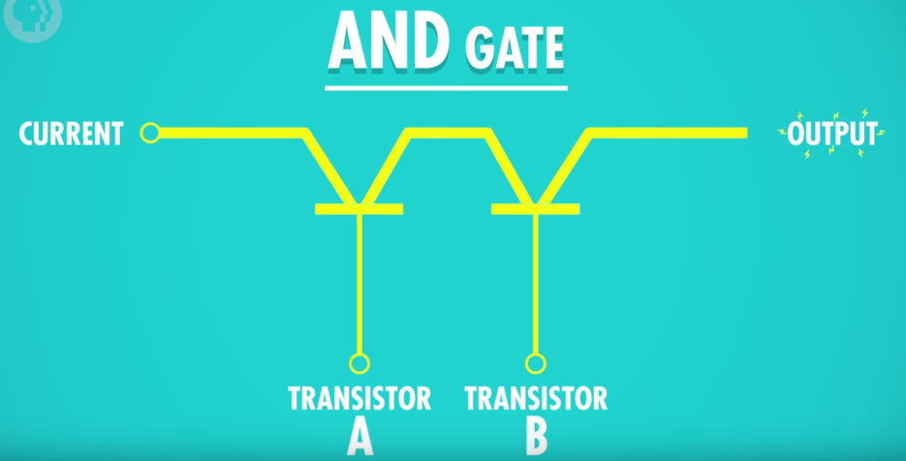
AND Gate
Transistor A: On (True)
Transistor B: On (True)
Output: On (True)
On (True)
On (True)
On (True)

Slide 16


Boolean Operations: OR
= FALSE
OR
FALSE
FALSE
OR Operation
Both input values must be FALSE for output to be FALSE
If Michael likes traffic OR Michael takes the train to work every day ☹. 🡪 False or False = False
Both inputs must be FALSE for an OR expression to be FALSE.
If Michael is to change his habits and use public transit 🡪 expression becomes true. (One true is enough)

Slide 17
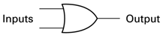
Boolean Operations: OR Gate
Truth Table
Inputs Outputs
0 0 0
0 1 1 0 = FALSE
1 0 1 1 = TRUE
1 1 1
OR Operation
At least one input value must be TRUE for output to be TRUE
0
0
0
0
1
1
1
1
0
1
1
1

Slide 18
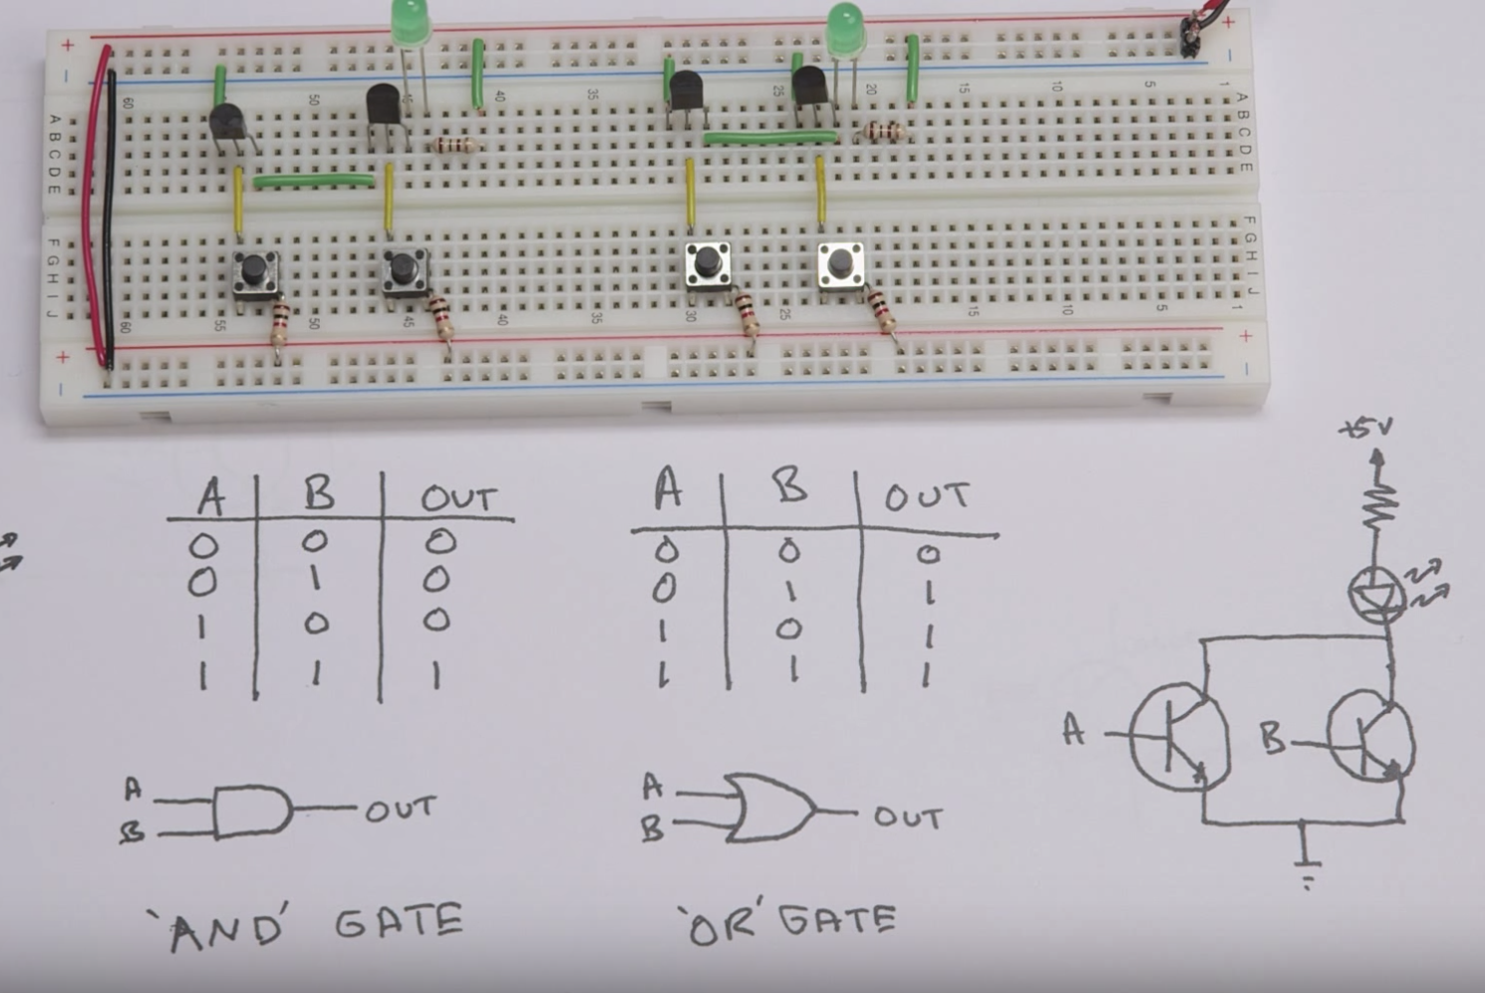
Logic Gates are circuits
Modern computers use transistors combined with resistors and diodes to build logic gates,
DIY Logic Gates: https://www.youtube.com/watch?v=sTu3LwpF6XI&t=481s&ab_channel=BenEater

Slide 19
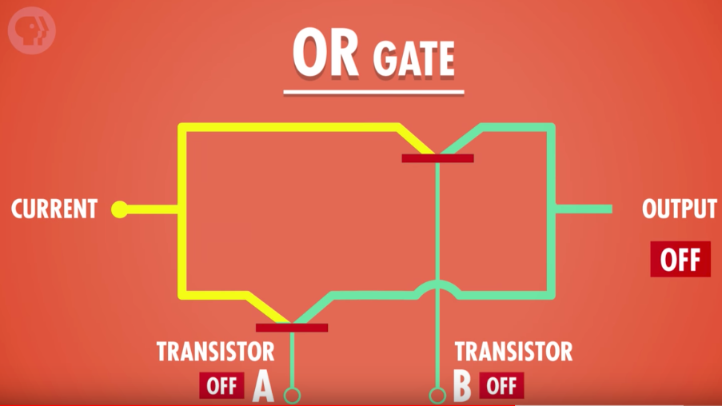
OR Gate
Two inputs (transistors A and B) and one output.
Transistor A: Off (False)
Transistor B: Off (False)
Output: Off (False)

Slide 20
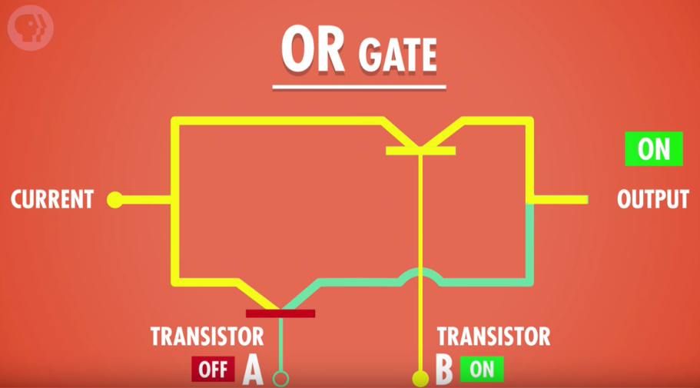
OR Gate
Two inputs (transistors A and B) and one output
Transistor A: Off (False)
Transistor B: On (True)
Output: On (True)

Slide 21
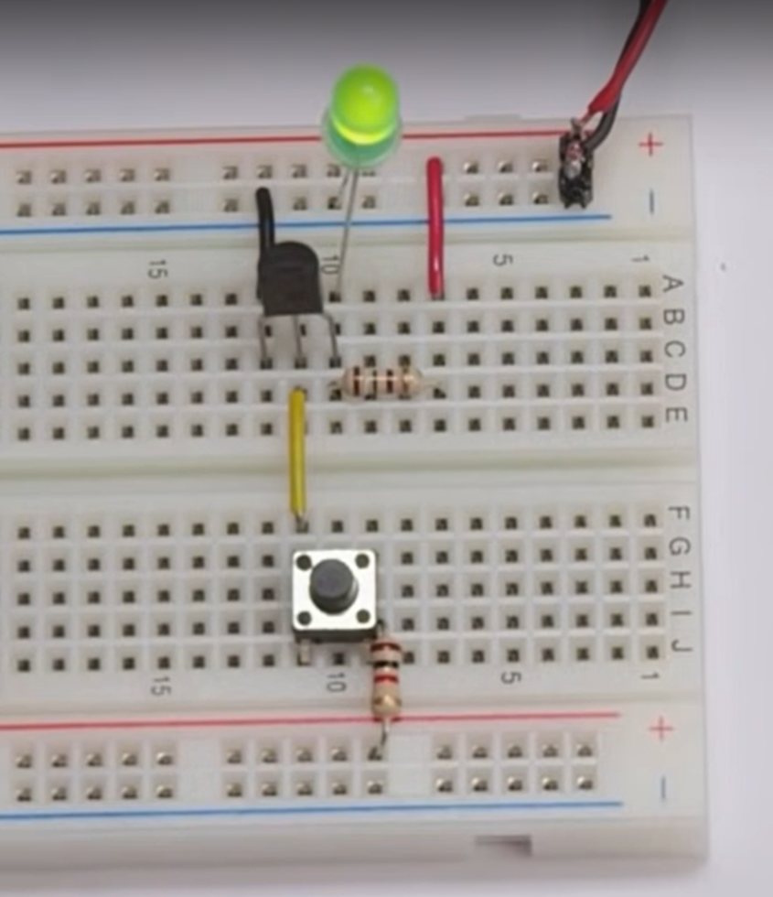
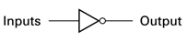
Boolean Operations: NOT
Truth Table
Inputs Outputs
0 1 0 = FALSE
1 0 1 = TRUE
NOT Operation
Only one input
Opposite of input (inverts input)
NOT FALSE = TRUE
NOT TRUE = FALSE
0
1
1
0

Slide 22
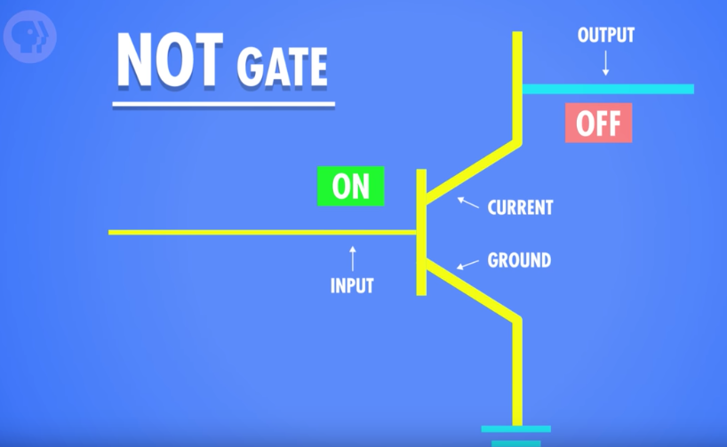
NOT Gate
To build an NOT gate: One transistor
One input and one output
Transistor A: On (True)
Current flows to ground wire and none to output, so output is Off (False)

Slide 23


Boolean Operations: XOR
TRUE
FALSE
OR
=TRUE
XOR Operation (Exclusive OR)
One and ONLY one input value can be TRUE for output to be TRUE
At noon Michael is going for lunch XOR Michael is going to class
If both were true, the output would be false! (as I cannot do both at the same time).
If both were false, the output will still be false

Slide 24
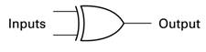
Boolean Operations: XOR Gate
0
Truth Table
Inputs Outputs
0 0 0
0 1 1 0 = FALSE
1 0 1 1 = TRUE
1 1 0
XOR Operation
Only one input value is TRUE for output to be TRUE
0
0
0
1
1
1
1
0
1
0
1

Slide 25
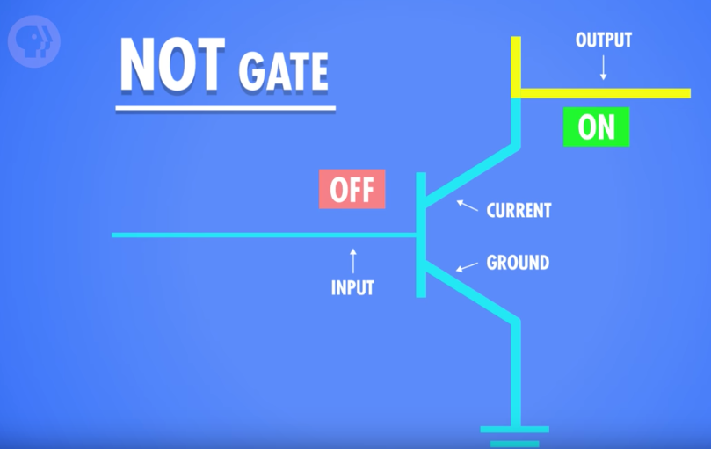
NOT Gate
Transistor A: Off (False)
Current flows to the output wire, so output is On (True)

Slide 26
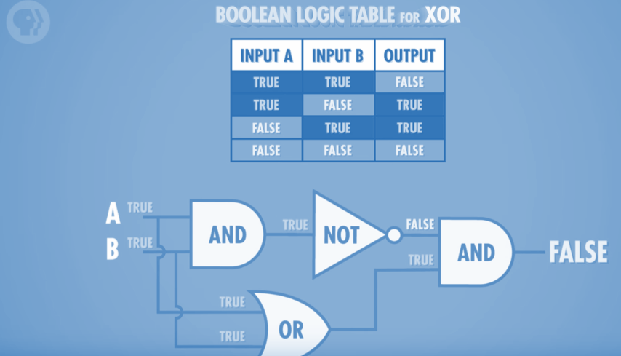
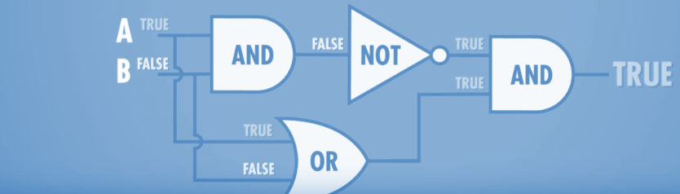
XOR Gate
How to build an XOR gate? We can’t do it directly with transistors-- but we can by combining AND, OR, and NOT gates!
Both of the images above are the same combination of gates; the only difference is the input values

Slide 27
Logic Gates and Binary Math

Slide 28
Activity: Digit Addition
Design a logic circuit made up of one of the simple gates we have seen so far: AND, OR, XOR, NOT to perform an addition A + B:
Addition truth table
A B | C S
0 0 | 0 0
0 1 | 1 0
1 0 | 1 0
1 1 | 0 1

Slide 29
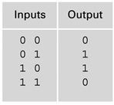
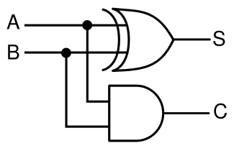
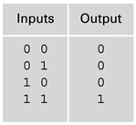
Half Adder Gate: Adding two bits
Inputs: A, B
S = Sum
C = Carry
A + B = 2’s 1’s

Slide 30
Half Adder Gate: Adding two bits
Inputs: A, B
S = Sum
C = Carry
A + B = 2’s 1’s
0 + 0 = 0 0
0 🡪
0
0 🡪
0

Slide 31
Half Adder Gate: Adding two bits
Inputs: A, B
S = Sum
C = Carry
A + B = 2’s 1’s
0 + 1 = 0 1
0 🡪
1
1 🡪
0

Slide 32
Half Adder Gate: Adding two bits
Inputs: A, B
S = Sum
C = Carry
A + B = 2’s 1’s
1 + 0 = 0 1
1 🡪
1
0 🡪
0

Slide 33
Half Adder Gate: Adding two bits
Inputs: A, B
S = Sum
C = Carry
A + B = 2’s 1’s
1 + 1 = 1 0
1 🡪
0
1 🡪
1

Slide 34
Full Adder
Why do we call it a half adder? Because if you are performing two additions in a row such as 1 + 1 +1
D

Slide 35
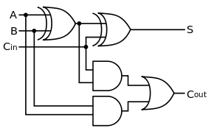
Full Adder
A | B | Cin | S | Cout
0 | 0 | 0 | 0 | 0
0 | 0 | 1
Homework….

Slide 36
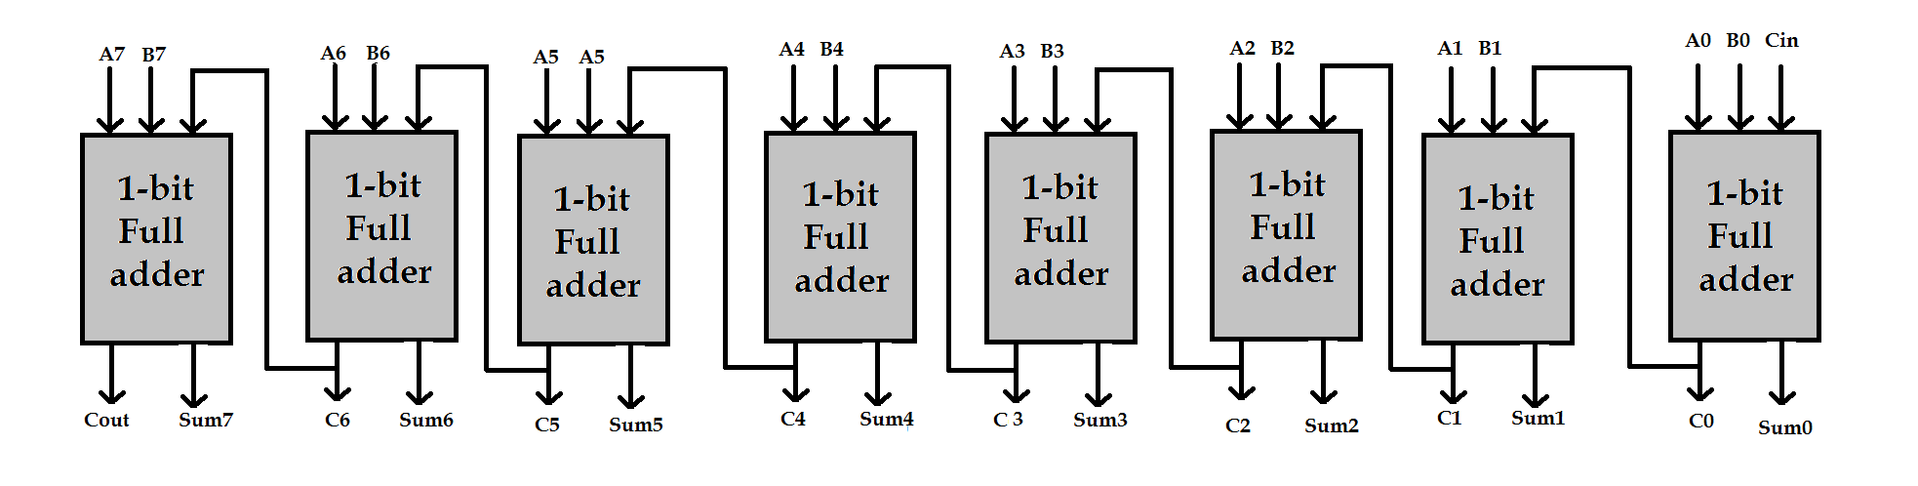
8 bits Full adders

Slide 37
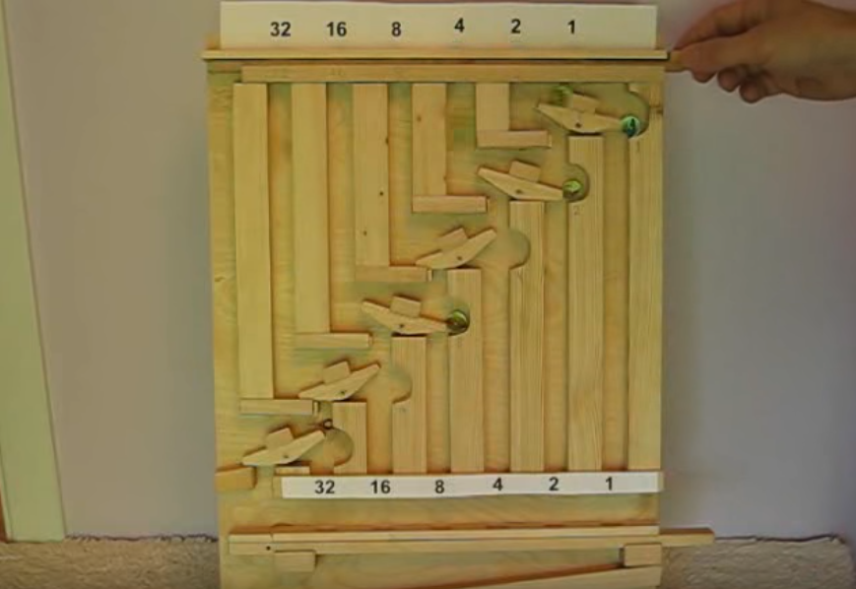
Marble Adding Machine
http://www.youtube.com/watch?v=GcDshWmhF4A&NR=1&feature=fvwp

Slide 38
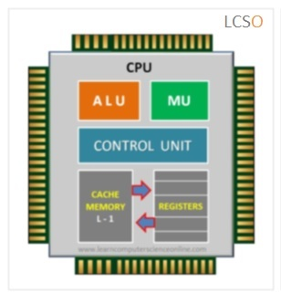
Back to the CPU
The CPU ALU (Arithmetic logic unit) is made up of a combination of logic circuits paced at the clock signal. The ALU is able to perform those operations:
Add
Add with carry
Subtract
Subtract with borrow
Two’s complement
Increment
Decrement
Pass through
Logical operations (and, or, xor, not or one’s complement)
Bit shift operation

Slide 39
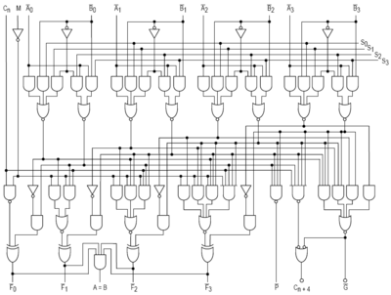
This is a 4-bit CPU

Slide 40
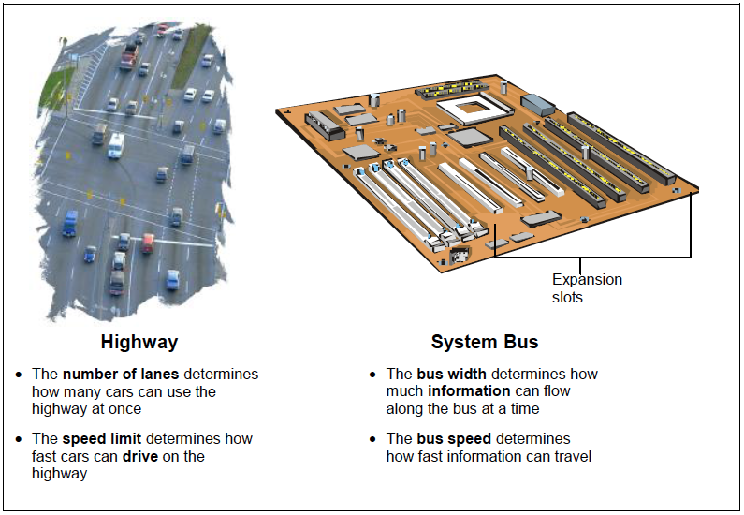
Why is the this important?
The logical circuits of the CPU determines the bus width of your system:
32-bit CPU
64-bit CPU
More on this in lecture 6...

Slide 41
Questions?

